Slide 1
Software Collaboration and versioning our code
Using git, eclipse git plugin and GitHub

Slide 2
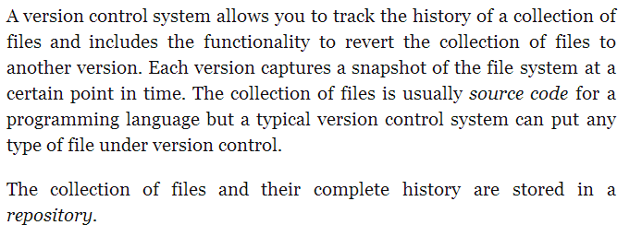
What is a version control system

Slide 3
Introduction to git
The way GIT works is by storing snapshots of the files that are commited into the repository.
GIT allows you to revert your code to a previous version (snapshot) or compare your current code with a previous snapshot, or compare to previous snapshots with each other.

Slide 4
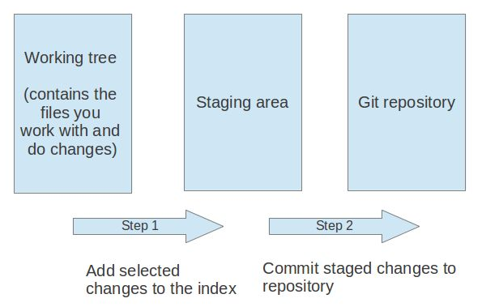
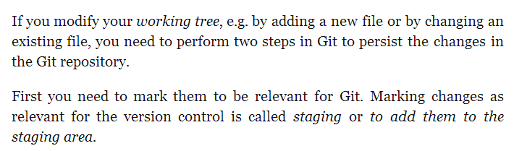
How to add changes to your git repository

Slide 5
How to set up a git repository
You can obtain git for Windows through the following link:
http://msysgit.github.io/
Click Download and you can install the application after you have completed the download. The instructions are pretty straight forward.
You can place the install using the default settings. You can choose the simplest configuration since we will be using an eclipse plugin to synchronise our code.

Slide 6
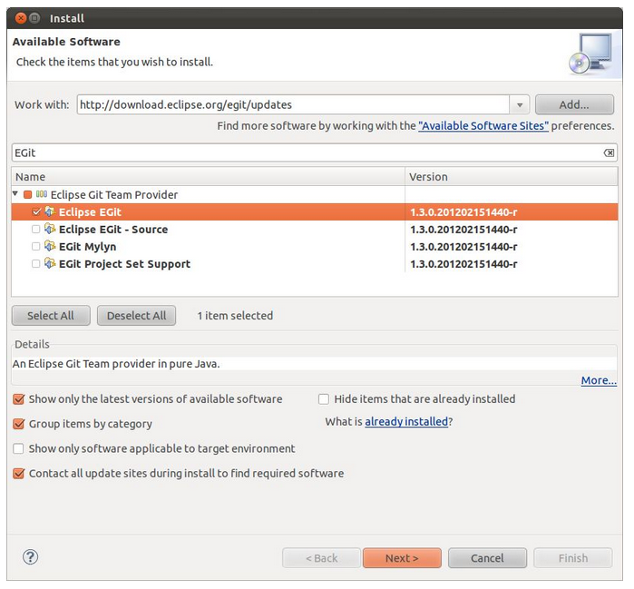
Eclipse git plugin
If you have installed the latest version of eclipse you will also have the E-git plugin.
For any reason you do not have the plugin you can obtain it from the following sight:
http://www.eclipse.org/egit/download/

Slide 7
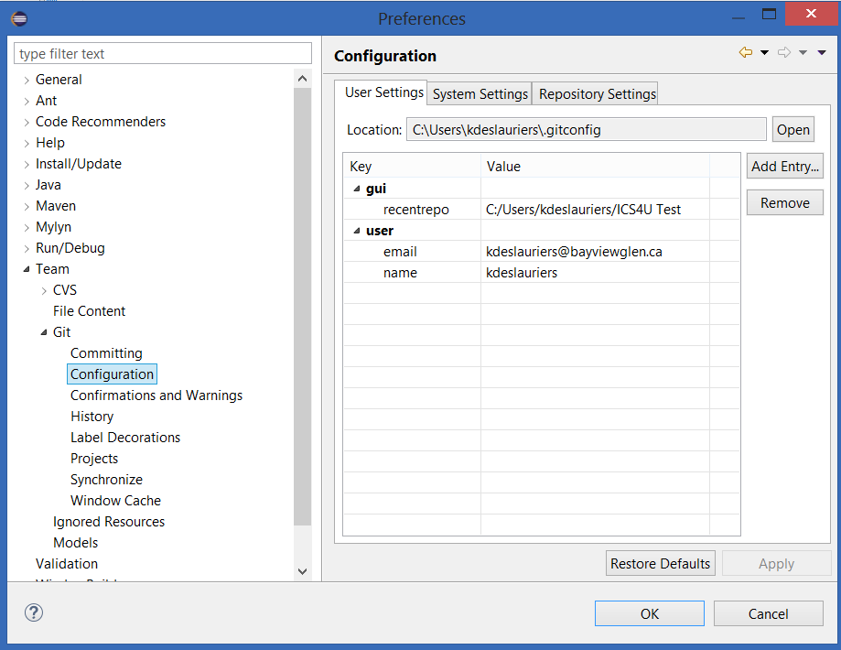
Setting up eclipse git
You will need to create two property entries under for user.
user.name => the name you want displayed when you commit code to the repository
user.email => the email you want associated with your user.

Slide 8
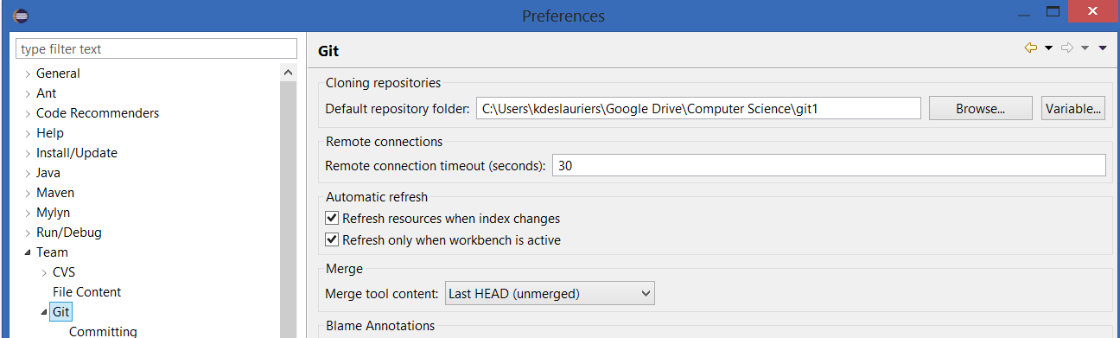
Setting up eclipse git
We also want to make our life easier when we create our repositories so we should choose a good default directory for git.

Slide 9
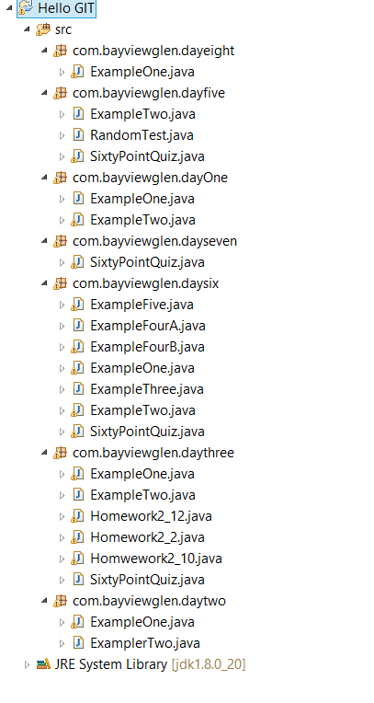
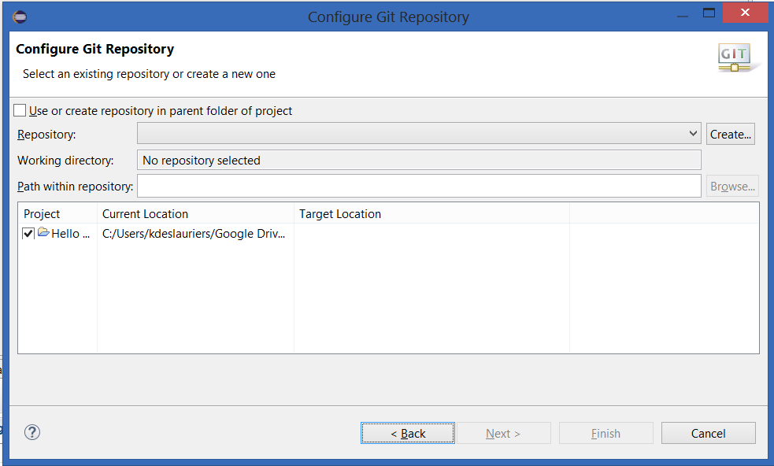
Sharing our first project
We can share our project by right clicking the project in the package explorer and selecting Team -> Share project and choose the option for Git.

Slide 10
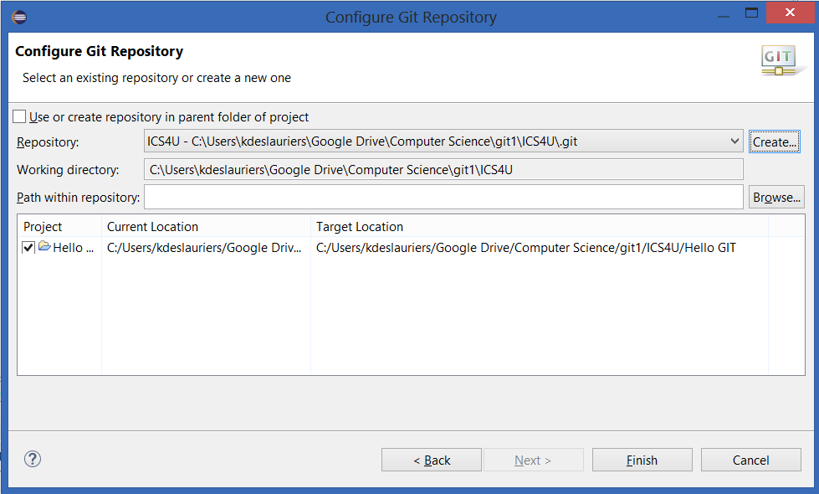
Sharing our first project
You will be presented with your default choice and you can now append a folder to it. I added ICS4U.
If you get an issue – try it again.

Slide 11
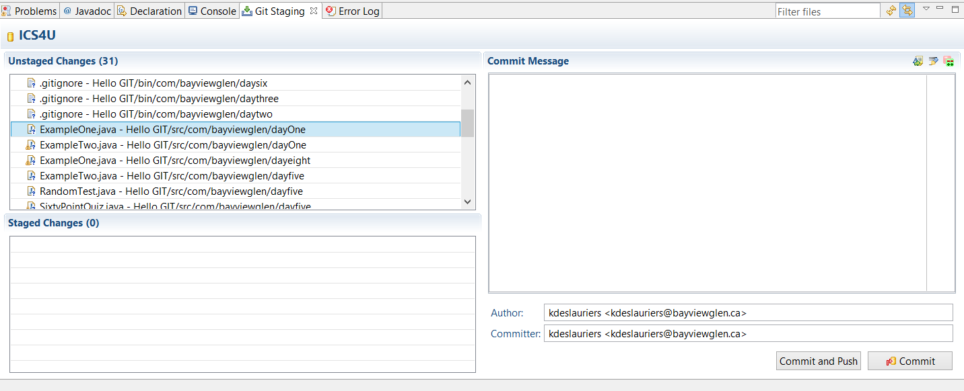
Performing our first commit
We can perform our first commit through the Git Staging View. You can add this view where ever you like within your Java perspective.
When you select a project in the Package explorer it will identify all the files that have changed since the last commit. That would be all of the files on our first commit.

Slide 12
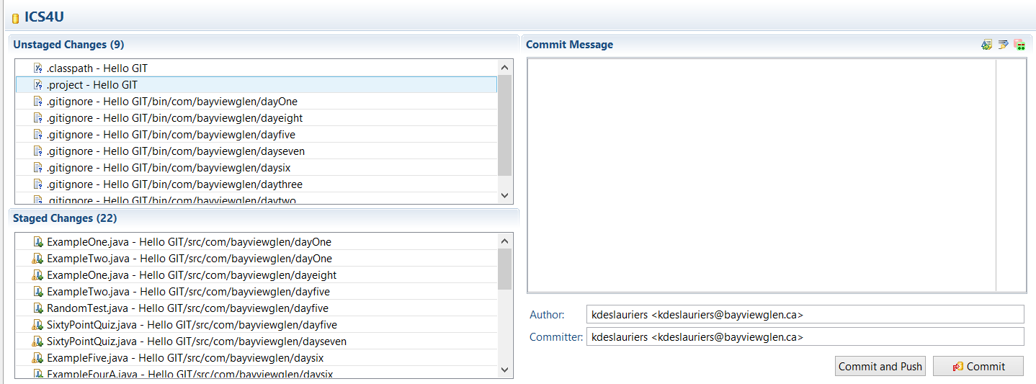
Performing our first commit
Move any files that you want to commit from Unstaged Changes to Staged changes.

Slide 13
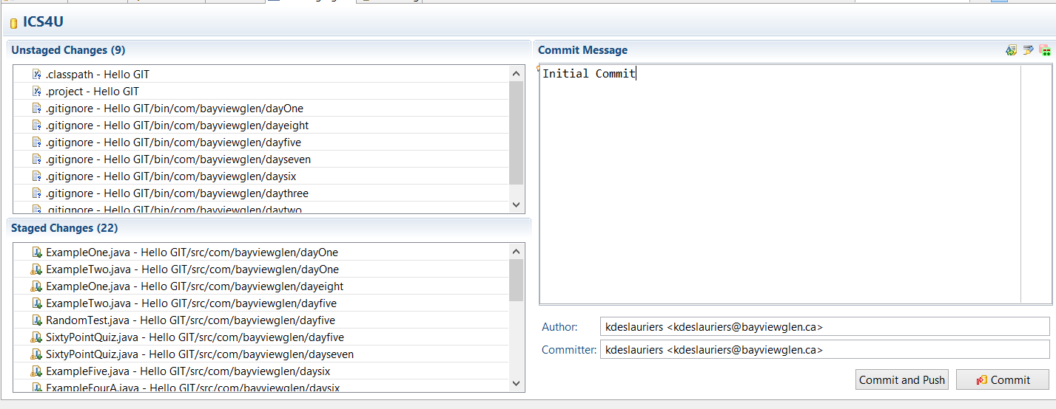
Performing our first commit
After you have placed a GOOD comment that anyone can read and understand what makes this snapshot different then the last you can click on the Commit button.

Slide 14
Git ignore
There will be files in which you will want to ignore and not be bothered by looking at them each time you perform a commit.
You can let git know that they should be ignored by selecting them from the unstaged changes and adding them to the .gitignore file.
You will also want to ignore the .gitignore as well since you won’t be committing that to your local repository.

Slide 15
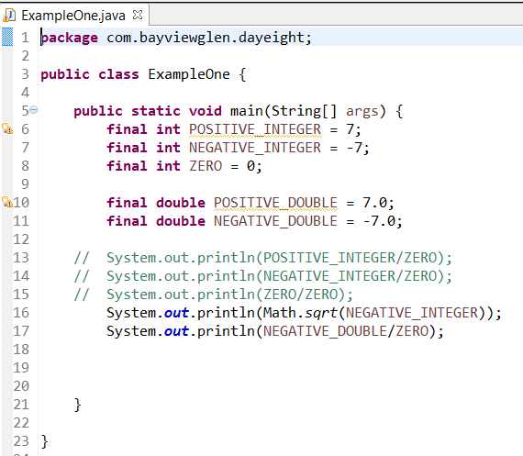
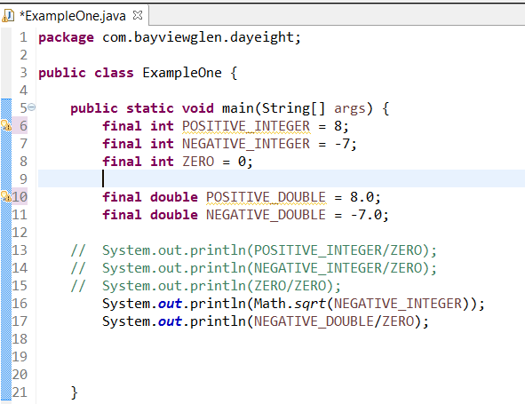
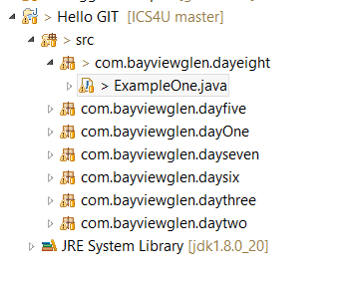
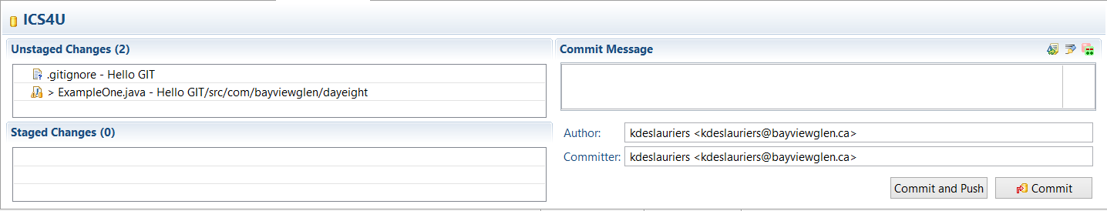
When changes are made

Slide 16
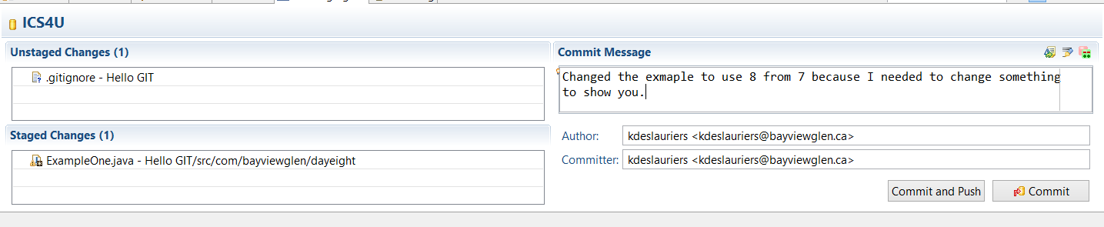
When changes are made
We have moved the file to the staged changes, added a good comment and selected Commit.

Slide 17
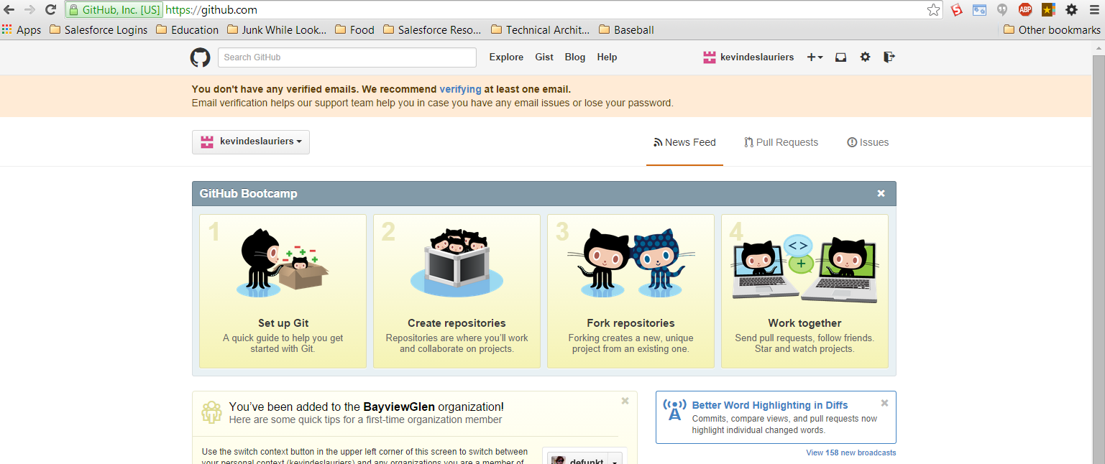
Sharing with others using a remote repository
You can signup for a github account and then download the desktop interface to store your code remotely so that other can access it.

Slide 18

Sharing with others using a remote repository
The Windows desktop application will make your life a whole lot easier by allowing you to interface your local repository with your remote repository on GitHub.
https://windows.github.com/
Place the icon in a location that makes sense. The application will ask which repositories on your local git you would like GitHub to access. Remember if you use the free account then everyone has access to your repository.

Slide 19
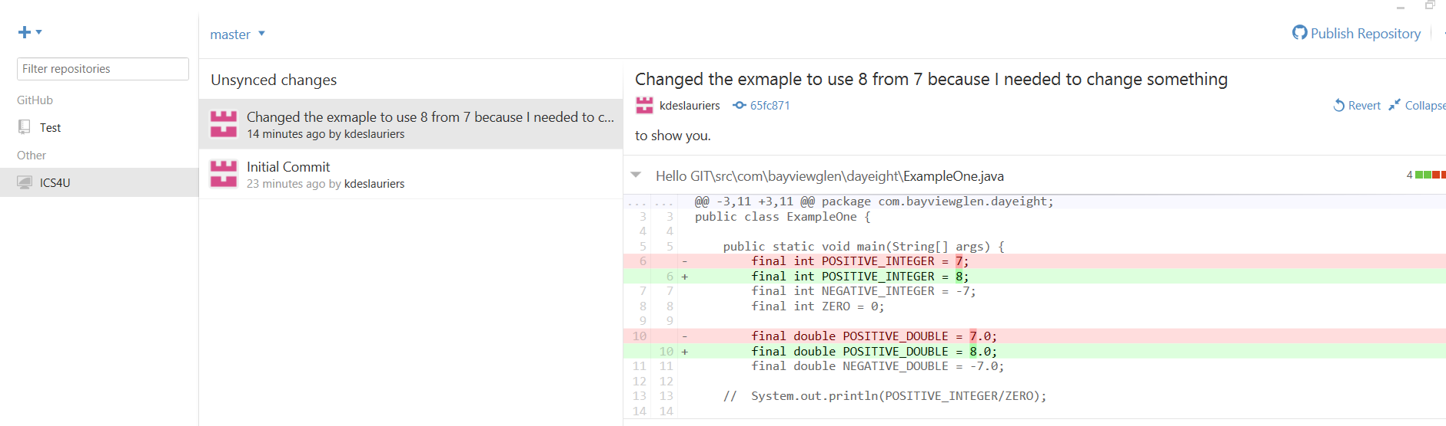
Your local repository in github App
From this view you can see everything that has happened in your local repository. We have yet to publish this to GitHub. So we are only looking at the local repository.

Slide 20
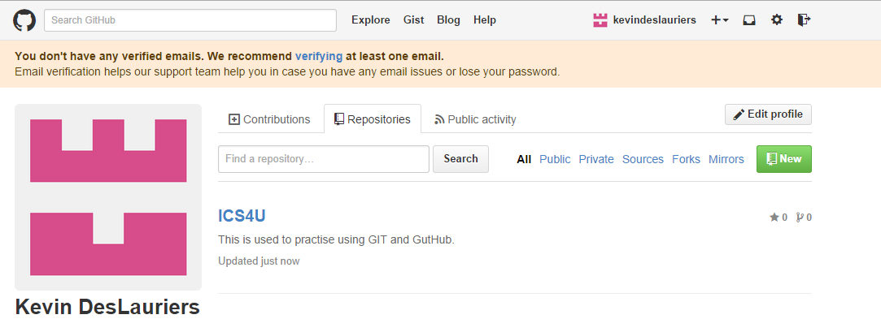
Eclipse and github
I have commited another change to my local repository and have decided to finally publish this to GitHub via the Publish link.

Slide 21
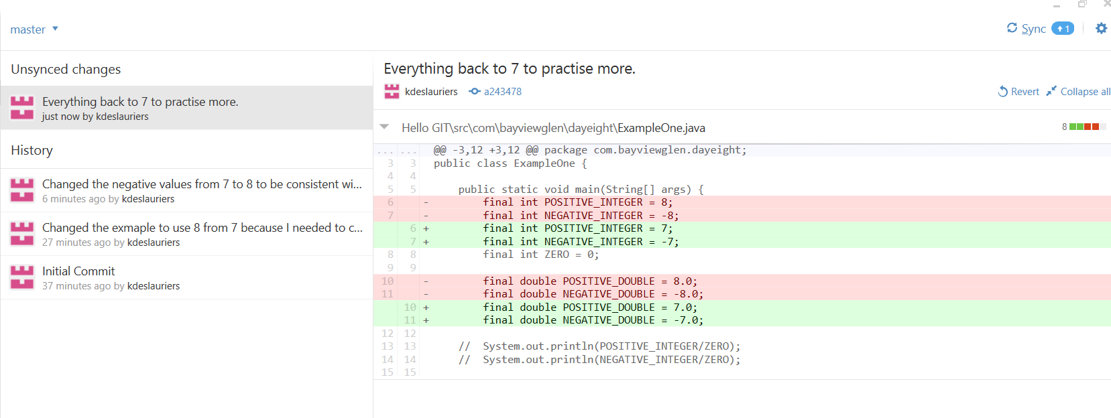
Syncing github

Slide 22
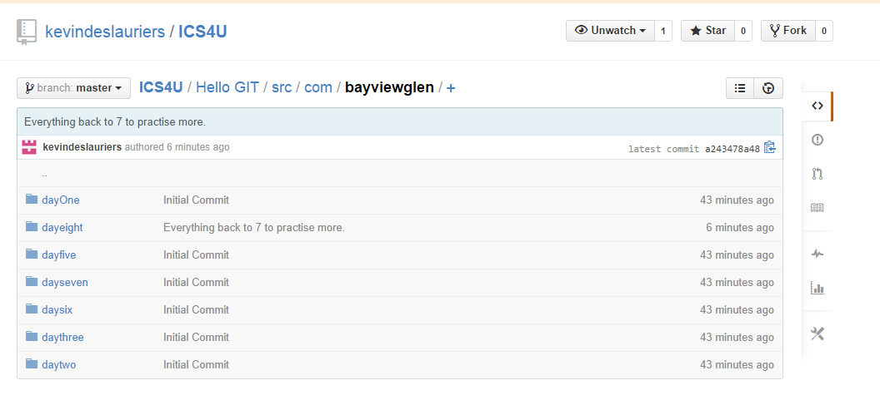
What does it look like in github - overview

Slide 23
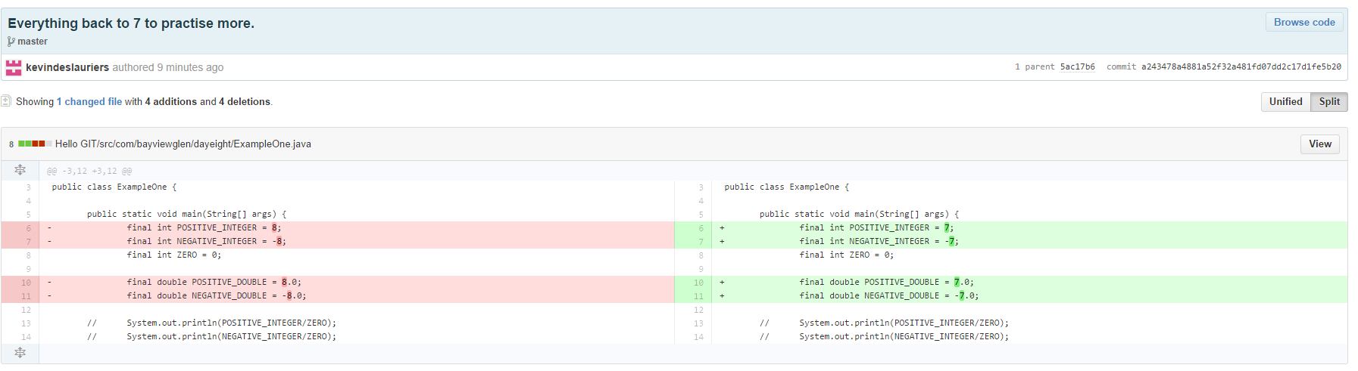
Drilling into a change
You can select a file and then choose to see the history.
History can be view in Unified or Split view. Below is an example of our most recent change in split view.

